Slide 1

Moving the Needle Ball
Maturing your PSIRT
FIRST PSIRT TC 2020 - Durham

Slide 2

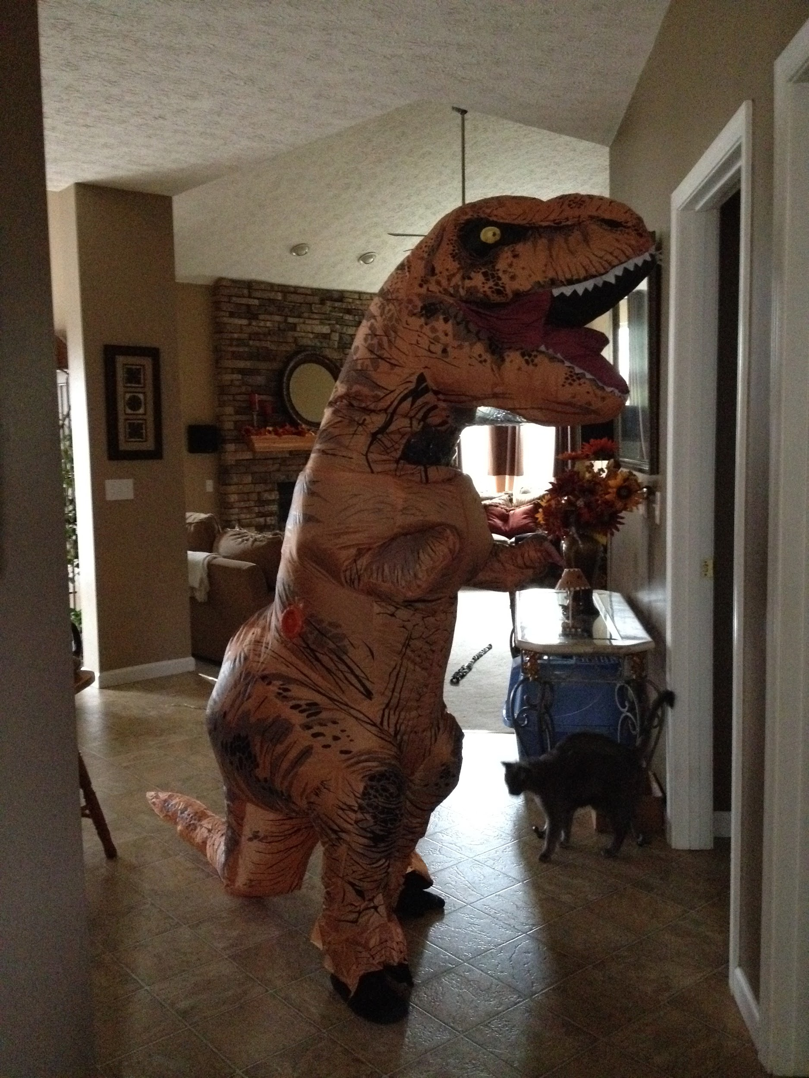
THIS.guy- - again
Notes:
Images - me!

Slide 3
Dr. B. Banzai
“Don't be mean. We don't have to be mean because, remember, no matter where you go, there you are.”

Slide 4
1.Introduction
THE Maturity
I’ don’t want to grow up, I’m a Toy’R’Us kid!

Slide 5


YOU MIGHT NOT HAVE EVER THOUGHT ABOUT IMPROVING YOUR MATURITY
TOO BUSY
NOT A PRIORITY MEOW
NEVER “DID THAT” BEFORE
So many meetings, so many reports to file, 1000 mails unread;, can an 80-hour work week be the norm?
Maybe you’ve got a 5-year plan, maybe you have nothing. Either way “MATURITY” isn’t on your list.
You’re pretty sharp with a CLI or Burpsuite, ...SWOTs and TOWS and assessments seem kinda fancy.

Slide 6

MATURITY CAN BRING A LOT OF BENEFITS
Increased Efficiency - COST SAVING!!!
Reduced Redundancy -- KINDA THE SAME THING, BUT
ZOMG...REDUCED COSTS
Better Stakeholder engagement - You ACTUALLY know who to talk to!
Improved governance and reporting - ZOMG...it’s full of NUMBERS!
CREATE raving fans - Customers LOVE being paid
attention to
Notes:
Image - https://images7.memedroid.com/images/UPLOADED792/5c419e079d8a5.jpeg

Slide 7

QUESTION FOR THE ROOM
How many of you have used the FIRST PSIRT Services Framework either as a reference or as a tool to improve your capabilities?
Follow-up: any cool stories folks would like to share?
Notes:
Image - https://image.shutterstock.com/image-vector/evolution-tattoo-dna-concept-scale-600w-691483894.jpg

Slide 8
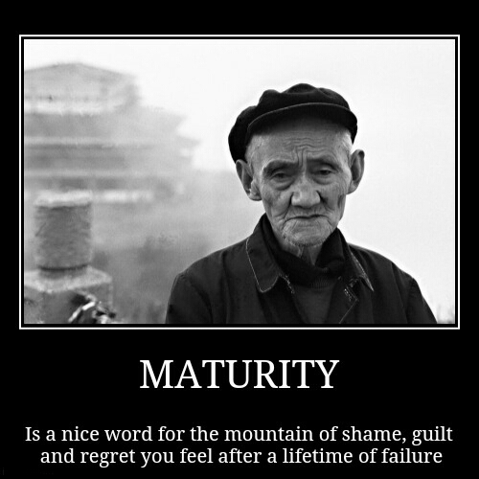
QUESTION FOR THE ROOM
How many of you have used the FIRST PSIRT Maturity Assessment resources (blogs, document, or Assessment sheet)?
Follow-up: What other methodologies might we be using to measure ourselves?
Notes:
Source - https://memeguy.com/photos/images/-maturity-276461.jpg

Slide 9

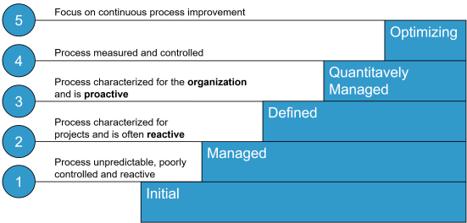
THIS IS ART. ART’S FRIENDS HAVE A SIMPLE SCALE YOU MIGHT USE TO MEASURE MATURITY
ART HAS COOL FACIAL HAIR. WE ALL SHOULD HAVE COOL HAIR
The Capability Maturity Model Integration - https://en.wikipedia.org/wiki/Capability_Maturity_Model_Integration

Slide 10

FUN FACT - The CMMI Scale is at the HEART of the FIRST PSIRT Maturity Assessment!

Slide 11

QUESTION FOR THE ROOM
What process/capability that your team provides adds THE most value to your customers?
Follow-up: How do you KNOW that?
Notes:
Source -https://i.imgflip.com/1gbvn9.jpg

Slide 12

QUESTION FOR THE ROOM
How many of you have a documented multi-year plan/roadmap to implement or improve your capabilities?
Follow-up: What types of things are you planning on tackling?
Notes:
Source - https://i.pinimg.com/originals/e3/e1/e4/e3e1e41d3e2b70084586424547889299.jpg

Slide 13
AWESOME WORDS

Slide 14
THANKS!
Do you have any questions?
crob_at_redhat_dot_com
@RedatCRob

